Slide 1
Eng : Mina Magdy
How To Start With Syber Security ?
< Linux Administration >
sscp,oscp,crtp,pts

Slide 2
>Liunx History
The history of Linux began in 1991 as a personal project by Finnish student Linus Torvalds to create a new free operating system kernel that resulted in the Linux kernel. Since the first release of the source code in 1991, it has grown from a small number of C-files and reached over 16 million lines of code in version 3.10 in 2013.

Slide 3
Background Information
Why You Must Use Linux ?
High security
High stability
Open Source
Education
Runs on any hardware
Free
Easy To Control
You Don’t Need Much Hardware Capabilities

Slide 4
< Linux Distributions >
Parrot Linux
Kali Linux
Ubuntu Linux
Arch Linux
Zorin Linux
Linux Mint

Slide 5
Redesigning The Prototype
How To Learn Linux ?
Learn Basics Commands
Typing speed
How Linux Works
Types And Differences Of Distributions ?
Learn Linux Services (Apatche2,FTP,SSH)
Show Manual Of Tools

Slide 6


Slide 7


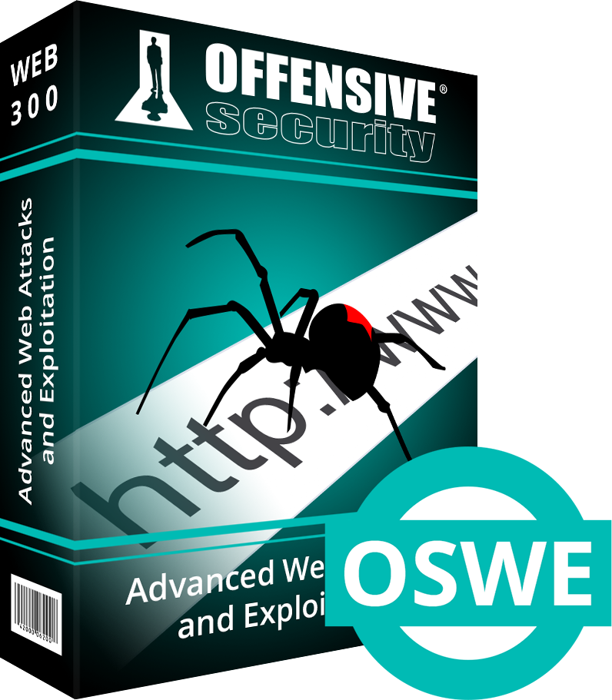
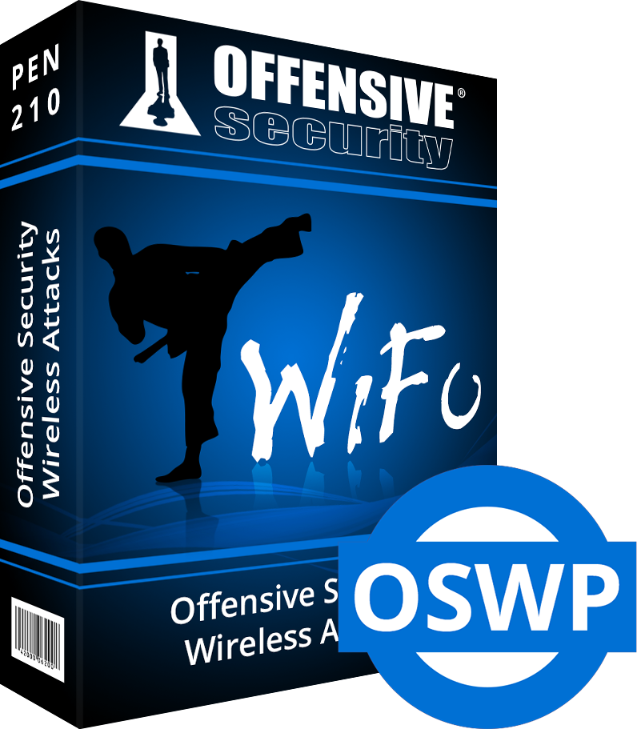
Top Security Certifications
OSCP - PWK
Offensive Security Certified Professional
OSEP
Offensive Security Experienced Penetration
OWAE - ASWE
Adavnced Web Attacks And Exploitation
OSWP
Offensive Security Wireless Professional

Slide 8
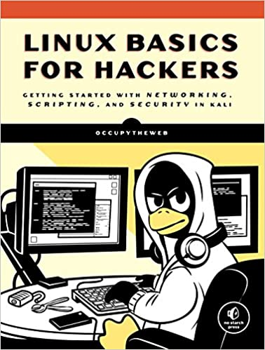



> Some Most Advanced BOOKS <
Liunx Basics For Hackers
How Linux Works
The Linux Command Line
MetaSploit Handbook

Slide 9
Final Result
Why U Must Use Linux
Tips For Linux Smart Learning
Some Linux Distributions And Differences
Some Offensive Security Certifications
Some Important Books

Slide 10
ASKING TIME ..??

Slide 11
You can Ask Me ON ?
Facebook : https://www.facebook.com/m3lomatthephone
My YouTube Chanel : https://www.youtube.com/c/m3lomatthephone
M3lomat the phone 2 : https://www.youtube.com/channel/UCixopZbFBzdYKk2qsZLsRCA
M3lomat Electric : https://www.youtube.com/channel/UCGnXhX2E_MaGYOY8kyOowbQ
Instagram : https://instagram.com/mena.m.rushdy?igshid=1xg5sxvjtek7i
LinkedIn : https://www.linkedin.com/in/mina-magdy-38362b1b6/
Facebook Group : https://www.facebook.com/groups/391033085092937

